Slide 1
Computer Networks (SWE3022-41)
Group
Activity #3
(2025/09/24)

Slide 2


Wireless Networks Problems
1
A
B
C
D
Explain the exposed terminal problem and hidden terminal problem and solutions for each problem.
Explain the differences among the following types of wireless channel impairments:
Pathloss
Multipath propagation
Interference from other sources

Slide 3
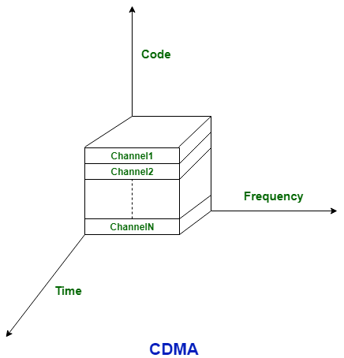
CDMA
2
Explain what CDMA is.
Explain the advantages and disadvantages of CDMA.
What is difference between “A simple CDMA (one sender, one receiver” and “Two sender CDMA”

Slide 4
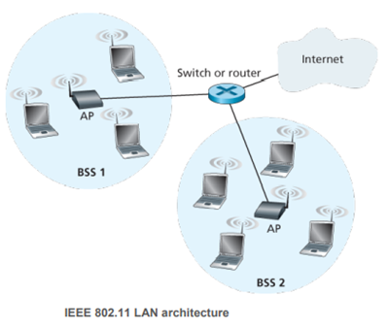
IEEE 802.11
3
There are several 802.11 standards for wireless LAN technology in the IEEE 802.11 (“WiFi”) family.
Explain the differences of 802.11a, 802.11b, 802.11g, and 802.11n regarding the frequency range and data rate.
What is the usage of 802.11i?
Describe the CSMA/CA Protocol procedure for IEEE 802.11.

Slide 5
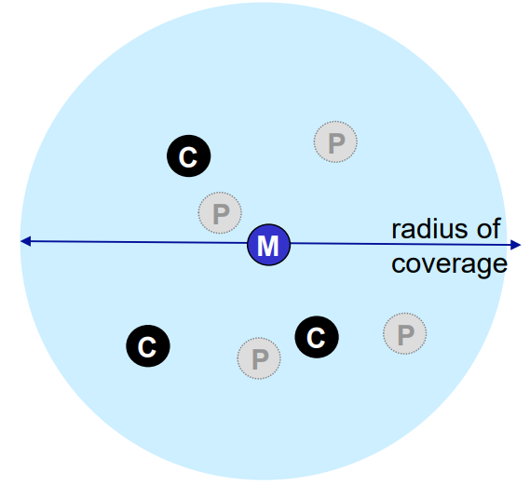
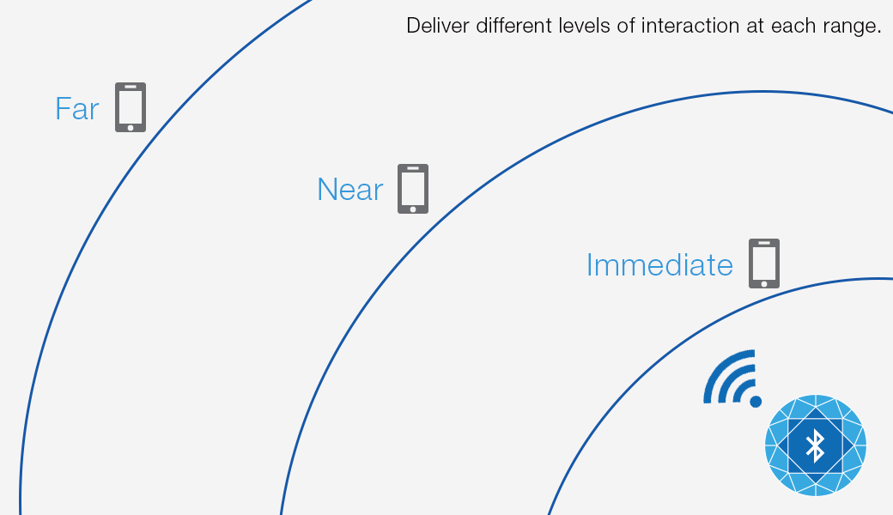
4
Personal Area Networks (PAN): Bluetooth
Explain what Bluetooth is.
Explain the master device, client device and parked device.
Explain the characteristics of Bluetooth:
Parked mode
Bootstrapping
Notes:
5

